Slide 1
AI that predicts
from your data
Who will default, leave, buy, fall sick or break down next, and can we trust the answer?
Leading with AI | Session 2 of the 15 (Sessions 0 to 14)
KLAi Professional Learning | Jotham Martin Wambi
Notes:
Welcome back. In Session 1 a model learned to see and read from thousands of labelled pictures and documents. Today the same learning turns to the records your organisation already keeps: loans, orders, claims, patients and customers. Our question: who will default, leave, buy, fall sick or break down next, and can we trust the answer?
We start with a Ugandan lender, build the idea from drawings, with no maths, tour six industries, and watch a model learn from past expense claims. Then you add a prediction of your own to your AI Opportunity Portfolio.

Slide 2



What you will leave with today
By the end of today you will have
Explain how a model predicts from past records, and name the three kinds: a yes or no, a number, a ranking
Ask the questions that show whether a prediction deserves trust: the data, the test on unseen records, the cut-off, and who decides
Add one or two predictions to your AI Opportunity Portfolio, each tied to a decision it would change
Notes:
By the end you will be able to explain how a model predicts from past records, and name the three kinds you will meet: a yes or no, a number and a ranking. You will hold the questions that show whether a prediction deserves trust: what it learned from, how it was tested, who set the cut-off and who decides.
And your portfolio will hold one or two predictions, each tied to a decision it would change.

Slide 3

Your two hours: the idea, the industries,
a demonstration, then your own portfolio
I run a recorded demonstration. You add a prediction to your own portfolio.
Notes:
Ten minutes to recall Session 1 and meet today’s question. Forty minutes on how a model predicts from past records, then the tour of six industries and three real cases. Fifteen minutes of demonstration, on recorded runs. A five-minute break. Ten minutes on your people and the questions to ask.
Then twenty-five minutes on your own portfolio, five on your decision, and ten to close with the take-away sheet. First, how today fits the course, and five words.

Slide 4
Three questions from last time
1. In Session 1, how did a model learn to tell a diseased leaf from a healthy one?
2. Reading a document and turning speech into text: new ideas, or the same one?
3. When does a picture model struggle?
Answer aloud first. Then we check together.
Notes:
Three quick questions from Session 1. Answer aloud first, and then we check together.
Question one. In Session 1, how did a model learn to tell a diseased leaf from a healthy one? Take a moment.
A good answer is this. From thousands of photos that people had already labelled diseased or healthy. It learned from labelled examples.
Question two. Reading a document and turning speech into text: new ideas, or the same one? Say it to yourself first.
A good answer is this. The same idea: learning from labelled examples, of printed or handwritten text and of recorded speech.
Question three. When does a picture model struggle? Think about your own work as you answer.
A good answer is this. When the new picture differs from the examples it learned from, such as a different camera or different light.
If an answer was missing, last session’s take-away sheet has it.

Slide 5
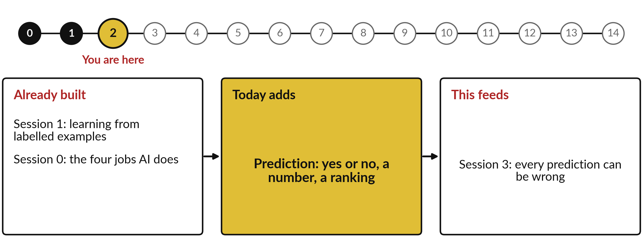
What today builds on, and where it leads
Each session is built on the ones before it.
Notes:
The dots along the top are the fifteen sessions, from the map at Session 0 to your plan at Session 14; the gold one is today.
Today uses learning from labelled examples from Session 1 and the four jobs AI does from Session 0.
It adds prediction: yes or no, a number, a ranking.
Session 3: every prediction can be wrong.

Slide 6
Words we use today
Word | What it means
Label | The known outcome in a past record, such as repaid or not repaid.
Score | The model’s estimate of how likely an outcome is, such as 8 in 10 likely to repay.
Threshold | The cut-off score your policy sets: above it one action, below it another.
Test set | Past records kept aside and never shown to the model, used to check it fairly.
Overfitting | Learning the slips and accidents of past cases, so the model does worse on new ones.
Notes:
Five words for today. We use every one of them before the end of the session.
Label. The known outcome in a past record, such as repaid or not repaid.
Score. The model’s estimate of how likely an outcome is, such as 8 in 10 likely to repay.
Threshold. The cut-off score your policy sets: above it one action, below it another.
Test set. Past records kept aside and never shown to the model, used to check it fairly.
Overfitting. Learning the slips and accidents of past cases, so the model does worse on new ones.

Slide 7
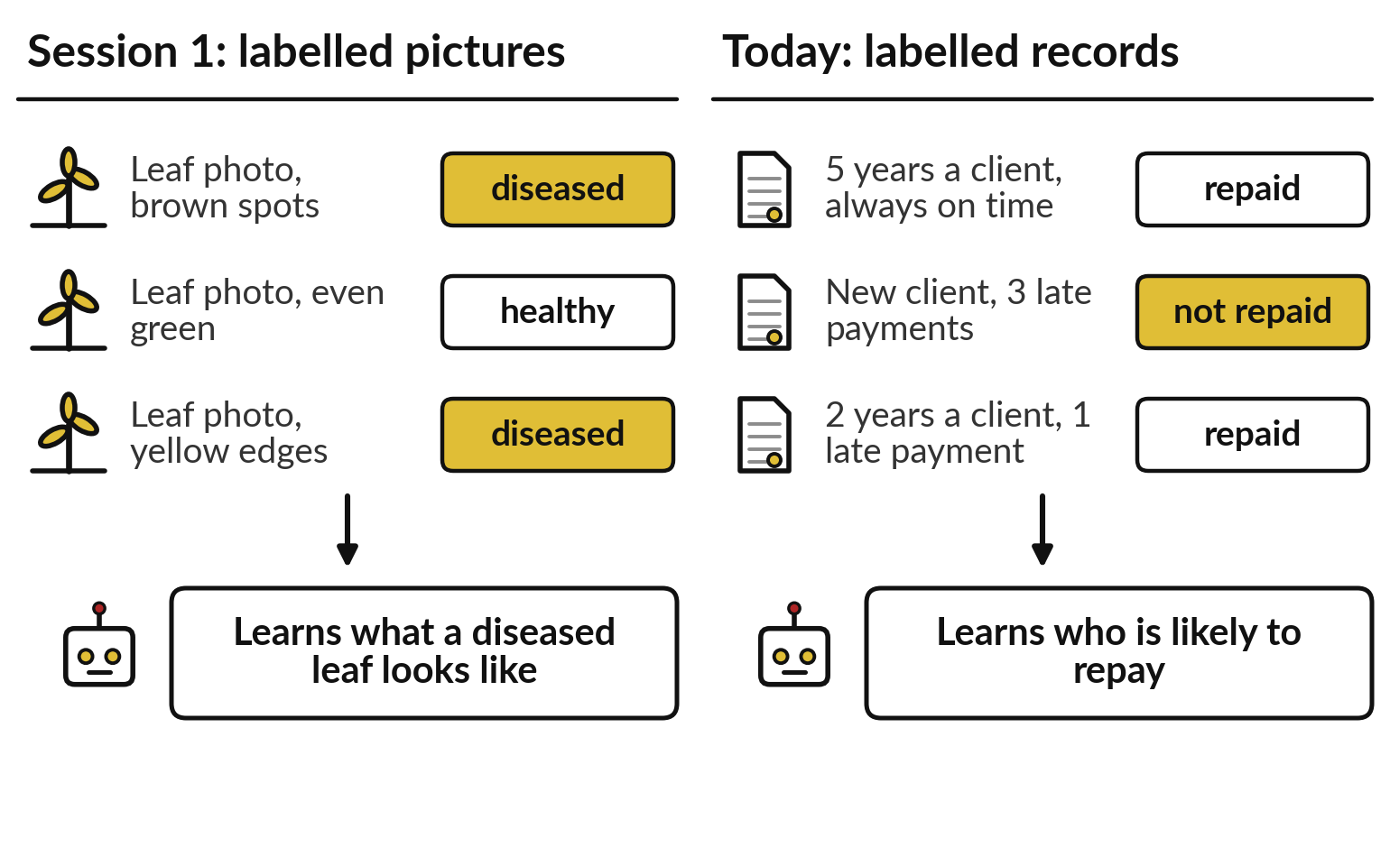
The learning that read labelled photos in Session
1 works on the records you already keep
Swap the photos for rows of records, and the label for what happened.
Predicting is the second of Session 0’s four jobs.
Notes:
Those five words all live in one idea, and you met its first half last session. In Session 1 a model learned to see from thousands of photos that people had already labelled: diseased leaf, healthy leaf. That is the left half of the slide; the right half is today.
Swap the photos for rows in your own records, a client, a shop or a machine, and swap the label for what happened: repaid or not, ordered or not, broke down or not. The model learns in the same way. In Session 0 we called this one of the four jobs AI does: predict. A Kampala lender already lives on it.

Slide 8
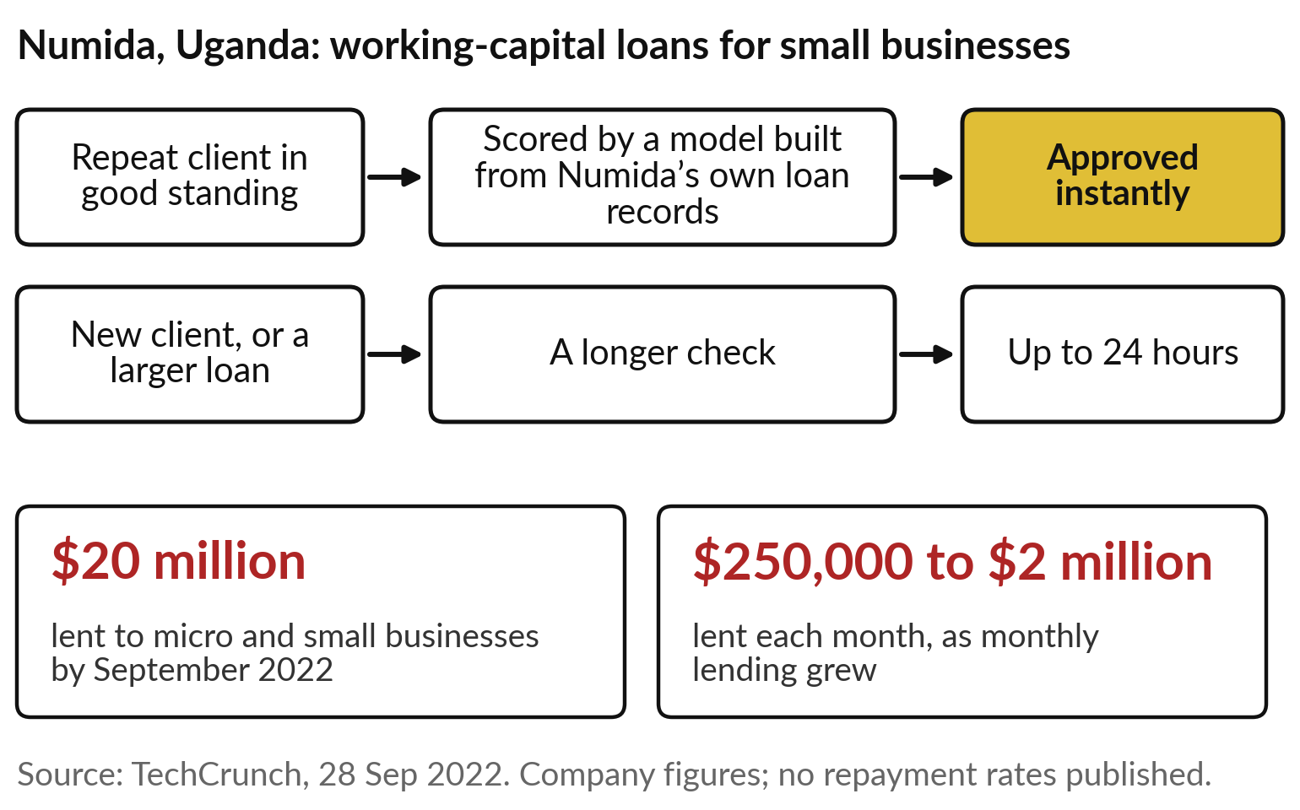
Numida in Kampala approves repeat borrowers
instantly, scored from its own loan records
No repayment rates were published, only lending volumes.
A new client, or a larger loan, takes up to 24 hours.
Our question today: who will default, leave, buy, fall sick or break down next?
Notes:
Numida lends working capital to small businesses, the shop or the salon that needs stock this week. A repeat client in good standing is approved instantly, because a model built from Numida’s own loan records scores them. A new client, or a larger loan, takes up to 24 hours.
By September 2022 it had lent 20 million dollars, and monthly lending had grown from 250,000 to 2 million dollars. Those are company figures from a funding story, and no repayment rates were published. Hold that gap in mind. Every organisation here has its own version of the question: who will default, leave, buy, fall sick or break down next?

Slide 9
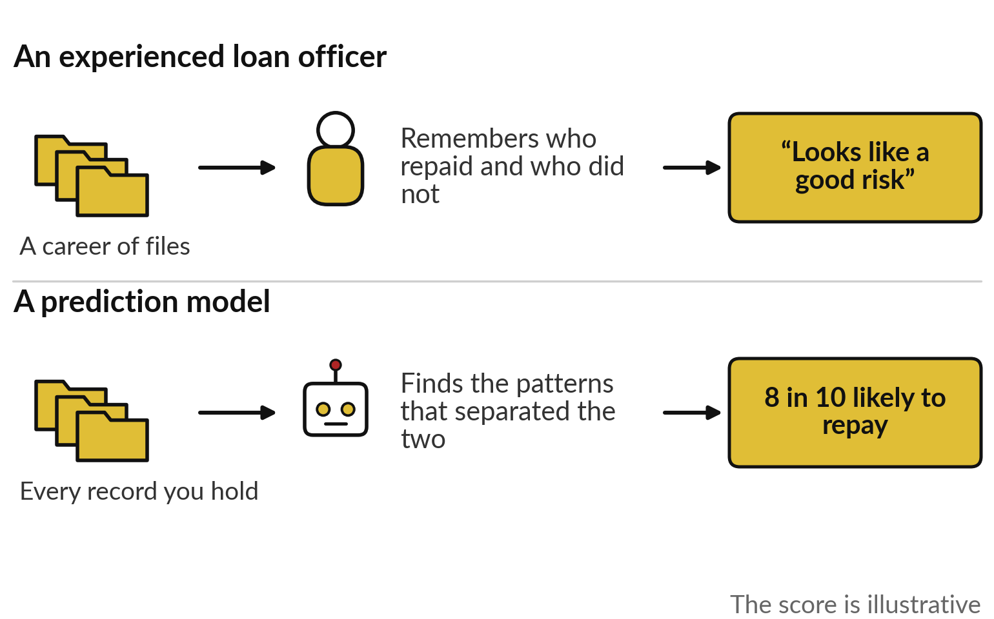
An experienced loan officer predicts from past
files; a model does the same with every record
Both judge a likelihood. Neither is certain.
The officer remembers a career of cases.
The model reads every record you hold, all at once.
Notes:
Before any software, recall the best loan officer you have worked with. Twenty years of files have given them a feel: this kind of business, with this kind of history, usually repays. When a new applicant walks in, they compare. A prediction model does the same with records instead of memory.
It looks at every past case you hold, all at once, finds what separated the clients who repaid from those who did not, and gives the new case a score, such as 8 in 10 likely to repay. That score is illustrative. Neither the officer nor the model is certain; both judge a likelihood.
What the model needs most is the outcome of every past case.

Slide 10
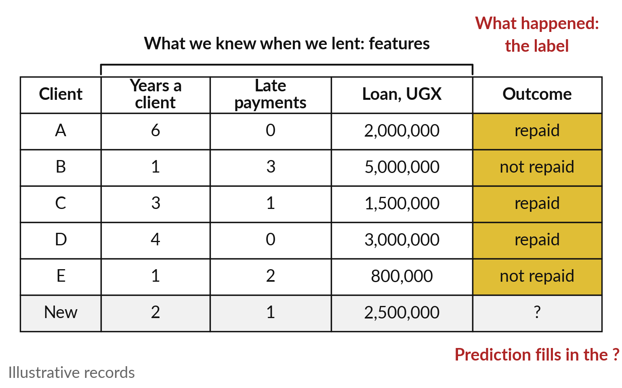
It needs past records in
which the outcome is known
Without the outcome column there is nothing to learn from.
The facts known at the time are the features; what happened is the label.
Learning from labelled records is called supervised learning.
Notes:
It needs records like these. Each row is a past client. The first columns are what we knew when we lent: years as a client, late payments and the size of the loan. The industry calls those facts features. The last column is what happened: repaid or not.
That outcome is the label, the word from our list. Learning from records that carry a label, as in Sessions 0 and 1, is called supervised learning. The last row is a new applicant, with features and no label yet. Prediction means filling in that question mark. Without the outcome column there is nothing to learn from, and that is the first test of your own data.

Slide 11
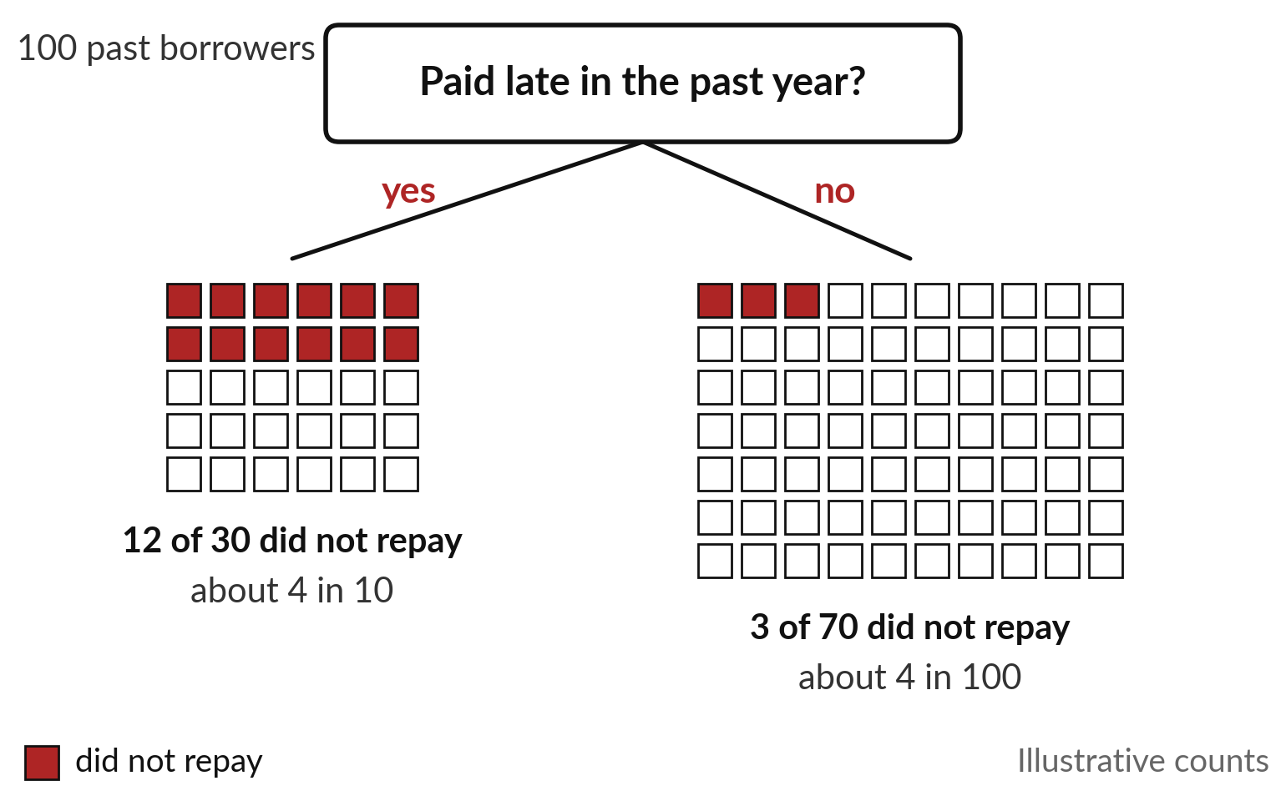
Learning means finding which facts
separated the good outcomes from the bad
One question about late payments splits 100 past borrowers.
A model tries thousands of such questions and keeps the ones that separate best.
The borrowers are invented for this slide.
Notes:
How does it find what separated them?
Take 100 past borrowers, invented for this slide, and ask one question: did they pay late in the past year?
Thirty did, and 12 of them did not repay, about 4 in 10. Seventy did not, and only 3 of those failed to repay. That single question separates risk well. A model tries thousands of questions like it, on every fact in the records, keeps the ones that separate best, and combines them.
A new applicant who paid late lands in the left group, so the model says about 4 in 10 risk. The answers it gives come in three shapes.

Slide 12
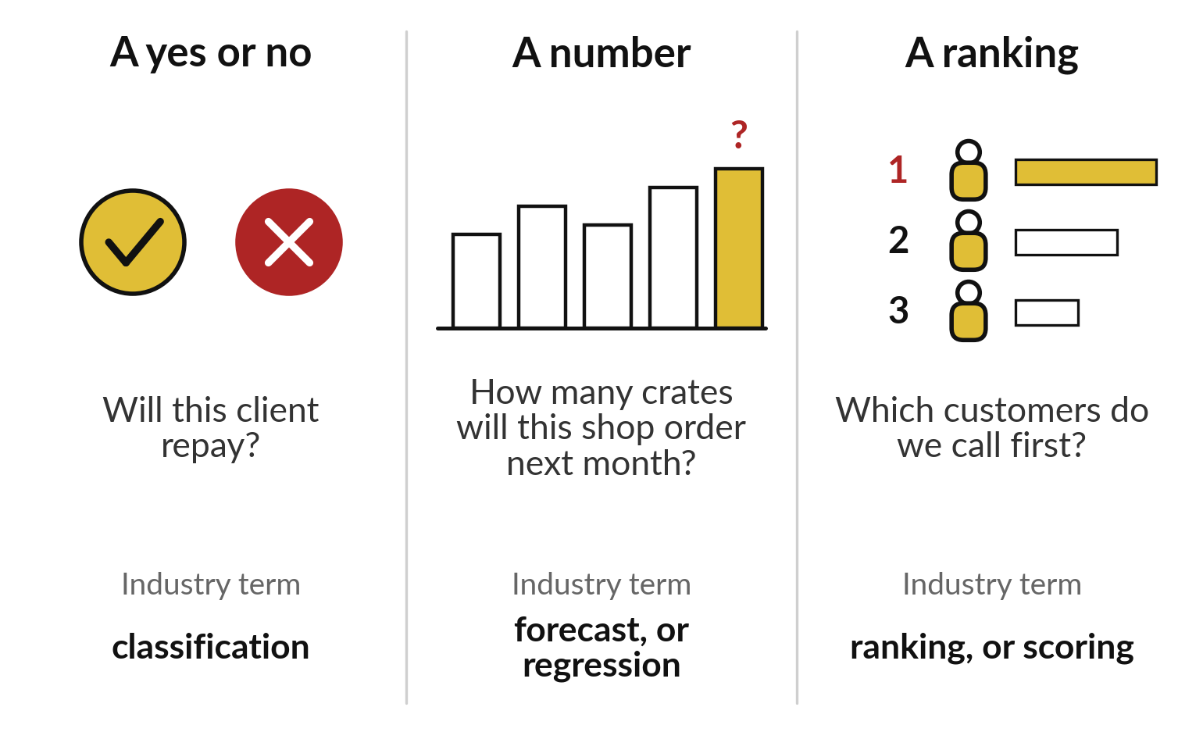
A prediction is a yes or no, a number, or a ranking
Ask a vendor which of the three a product gives you.
Each shape feeds a different decision.
A ranking is often the yes-or-no score, sorted.
Notes:
Those shapes cover most of what you will be offered. The first is a yes or no: will this client repay, is this claim in order, will this customer leave?
The industry calls it classification. The second is a number: how many crates will this shop order next month, how much cash will we need in March?
That is a forecast, which data people call regression. The third is a ranking: of five thousand customers, whom do we call first?
Often it is the yes-or-no score, sorted from high to low. When a vendor shows you a product, ask first which of the three it gives you, because each feeds a different decision.

Slide 13
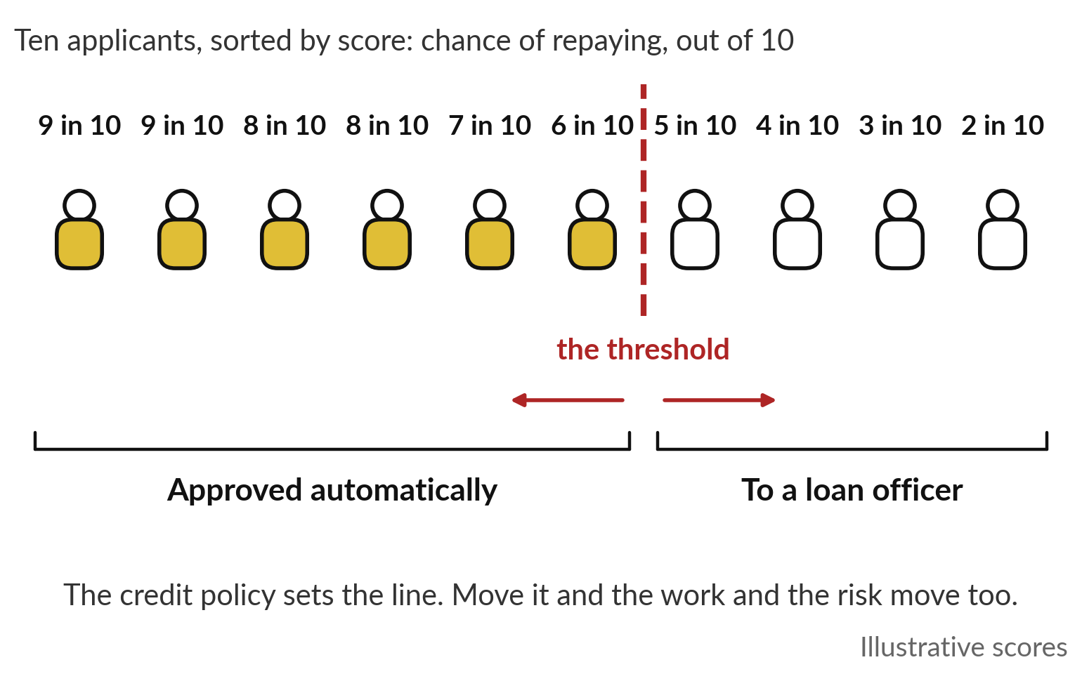
A score is a likelihood, and someone
in your organisation sets the cut-off
The model says 8 in 10. Your policy decides what 8 in 10 means.
The cut-off is called the threshold.
Session 3 prices the mistakes on each side.
Notes:
A yes or no hides one more choice. A model rarely says yes or no outright. It gives a score: this applicant is 9 in 10 likely to repay, that one 5 in 10. Someone must decide where the line falls, and the industry calls that line the threshold.
Here the policy approves 6 in 10 or better automatically and sends the rest to a loan officer. Move the line left and fewer loans are approved automatically, so officers get more work. Move it right and more are approved, with more risk. The model does not choose the line; your credit committee does. Session 3 puts a price on the mistakes either side.

Slide 14
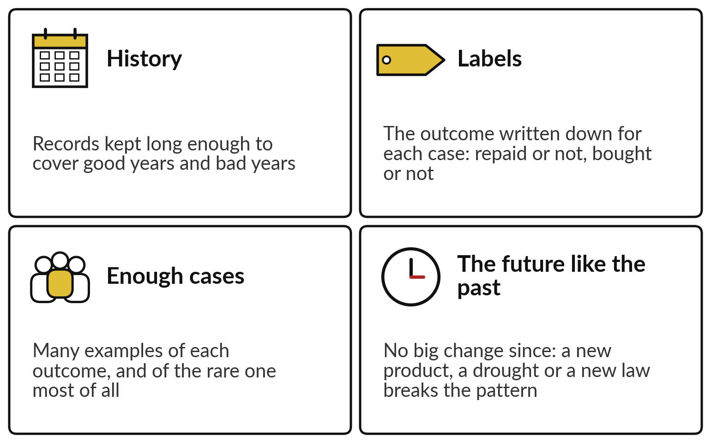
Your data decides what it can learn: history,
labels, enough cases, and a future like the past
Four checks before anyone builds a model.
If one fails, every score is weaker.
You run them on your own records in the hands-on.
Notes:
A score is only as good as what it learned from, and four checks tell you how good that is. History: records kept long enough to include good years and bad years, or the model has never seen a downturn. Labels: the outcome written down for every case.
Many organisations keep the application form but never record what happened. Enough cases: many examples of each outcome, the rare one most of all. If only twenty clients ever defaulted, the model has twenty lessons. And the future like the past: a new product, a drought, a new law or a pandemic changes the pattern, as Session 1’s digit network fell from 97 in 100 to 46 when the digits moved one dot.

Slide 15
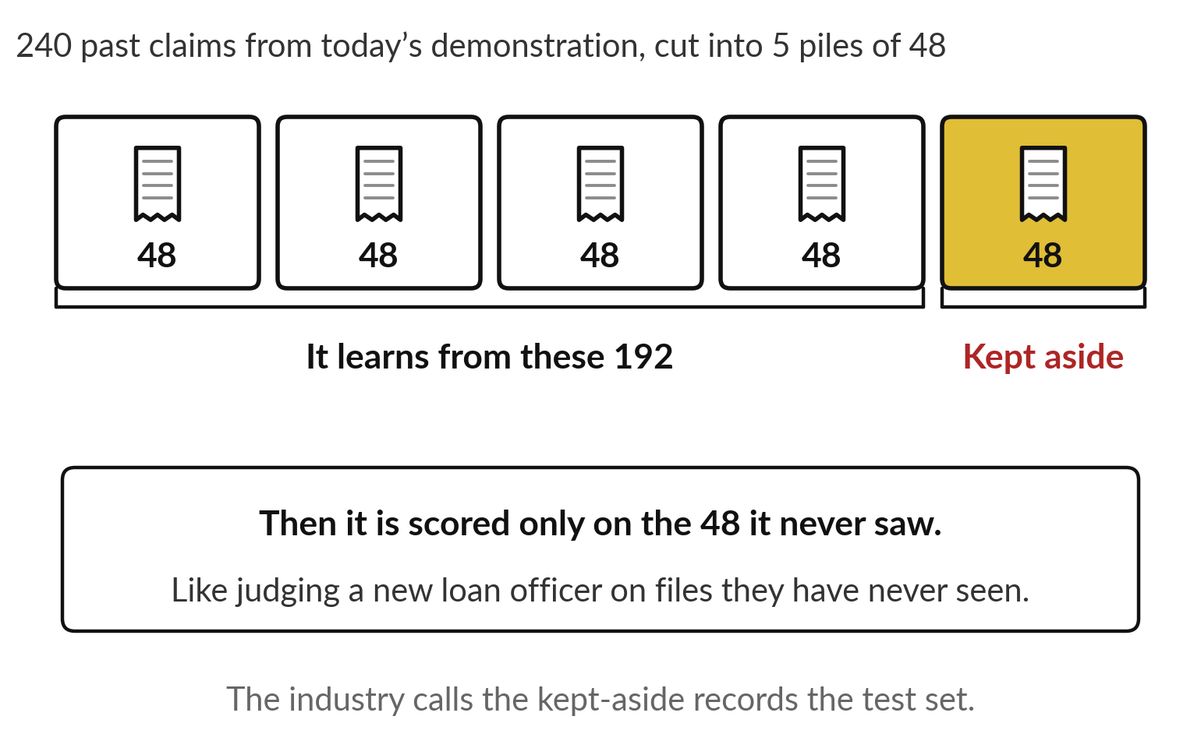
Test it fairly by keeping some records
aside and scoring the model only on those
A model will look excellent on the cases it learned from.
Keep about 1 record in 5 aside.
Ask any vendor for the score on records the model never saw.
Notes:
How do we know a model learned anything useful?
The way you would test a new loan officer. You would not judge them on the files they trained on; you would hand them files they have never seen. We do the same with a model. Before it learns anything, we keep some records aside, here 48 of the 240 expense claims from today’s demonstration.
It learns from the other 192. Then we score it only on the 48 it never saw. The industry calls those kept-aside records the test set. Ask a vendor or your own team for the score on records the model never saw. It guards against a habit models share with people.

Slide 16
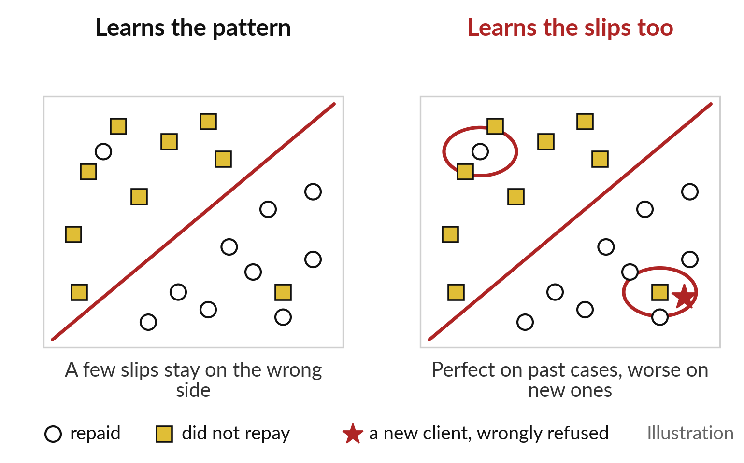
A model can learn the slips in its past cases and
then fail on new ones, which is called overfitting
Like an officer who remembers one odd case and makes it a rule.
Perfect on past records, worse on new clients.
The fair test on unseen records catches it.
Notes:
That habit is learning too much from odd cases. An officer once saw a client from one street default, and now refuses everyone from that street. On the slide, circles repaid and gold squares did not. On the left, the model draws one simple line. A few cases sit on the wrong side; they were slips and accidents, and it lets them go.
On the right, the model bends its line around every slip, so it is perfect on the past. Then a good new client, the red star, lands inside one of those loops and is refused. That is overfitting: learning the slips, and doing worse on new cases. The fair test you just saw catches it.

Slide 17
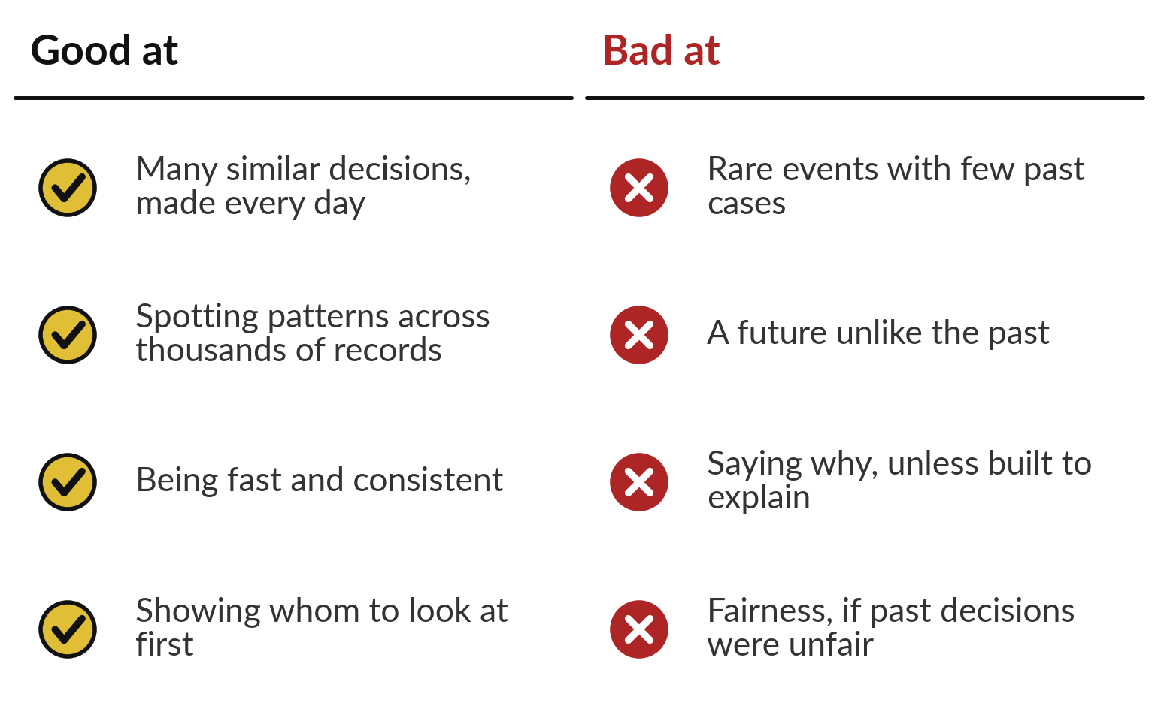
Prediction is good at many similar decisions,
and bad at rare events and a changed world
Use it where decisions repeat and records are rich.
If past decisions were unfair to one group, it learns that too.
Notes:
Together, these slides show where prediction earns its keep. It is good at many similar decisions made every day, such as small loans, orders or claims. It spots patterns across more records than any person can read, works fast and the same way every time, and is good at showing whom to look at first.
It is weak where the past is thin or misleading: rare events with few past cases, a future unlike the past, and saying why, unless it was built to explain. And if past decisions were unfair to one group, it learns that unfairness too; Session 3 returns to it. Organisations near you already use it.

Slide 18
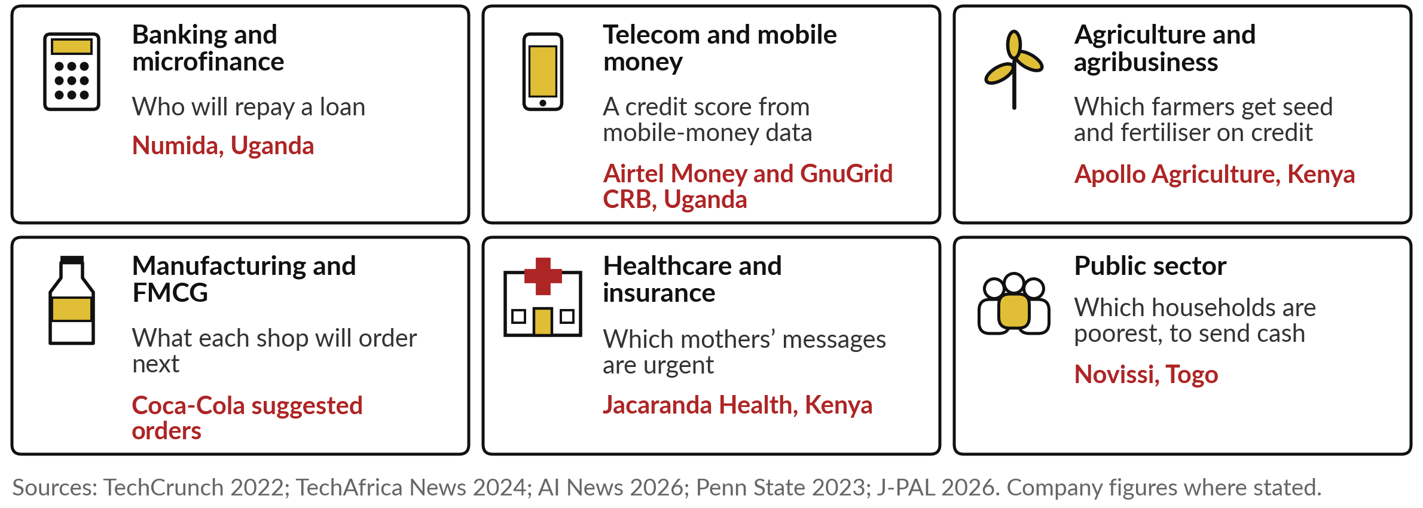
Banks, telcos, farms and ministries in
Africa already score customers this way
Airtel Money’s 2024 credit score in Uganda draws on 14 million mobile-money wallets.
Notes:
Every one of the six main industries has a named example. In banking and microfinance, Numida scores who will repay. In telecom and mobile money, Airtel Money and GnuGrid launched a credit score in Uganda in 2024, drawing on 14 million mobile-money wallets. In agriculture, Apollo Agriculture in Kenya decides which farmers get seed and fertiliser on credit, partly from satellite images of their farms.
In manufacturing and FMCG, Coca-Cola suggests what each shop should order. In health, Jacaranda Health scores text messages from mothers for danger signs, so urgent ones are answered first. And in the public sector, Togo used phone data to find the poorest households for emergency cash. Find your own industry’s tile.

Slide 19
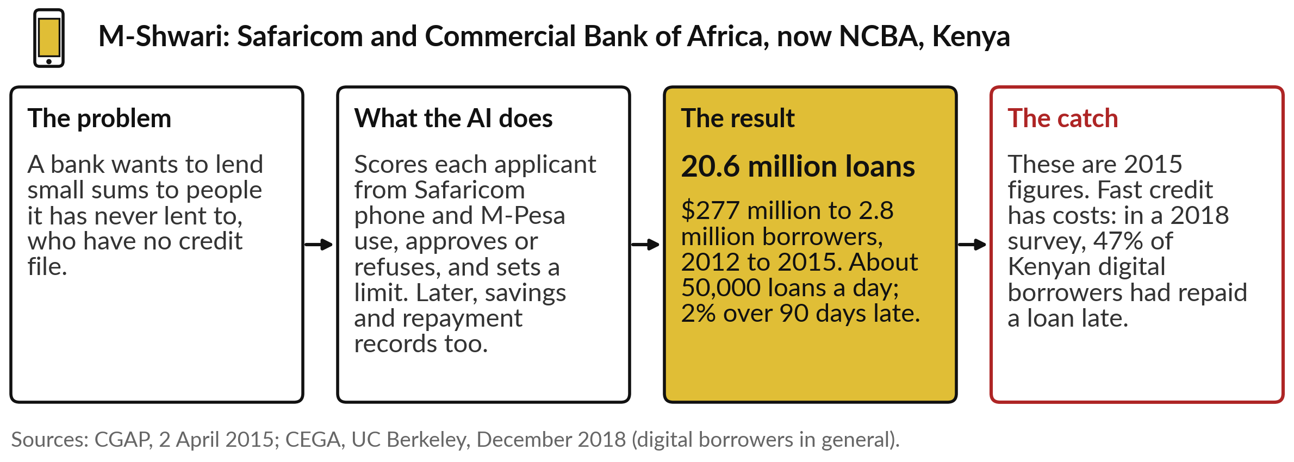
M-Shwari in Kenya made 20.6 million small loans to
people with no credit file, scored from phone records
Automated: the score approves or refuses, and sets the limit.
Notes:
M-Shwari is the founding case of credit scored from phone data. A bank wanted to lend small sums to people it had never lent to, with no credit file. The answer, from Safaricom and the Commercial Bank of Africa, now NCBA, was to score each applicant from their phone and M-Pesa use, then approve or refuse and set a limit.
By 2015, CGAP counted 20.6 million loans worth 277 million dollars to 2.8 million borrowers, about 50,000 loans a day, with 2 per cent more than 90 days late. Those are 2015 figures, and fast automated credit has costs. In a 2018 survey, 47 per cent of Kenyan digital borrowers in general had repaid a loan late.

Slide 20
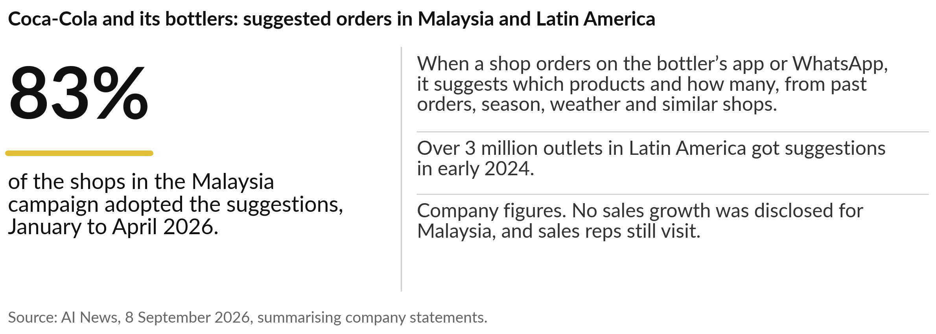
Coca-Cola suggests how much each shop
should order, and the shopkeeper decides
Adoption is a start; the test is whether sales grow.
Notes:
The second story predicts a number. A small shop that orders too little runs out; one that orders too much ties up its cash. When a shop orders through a Coca-Cola bottler’s app or on WhatsApp, the system suggests which products and how many, from past orders, the season, the weather and similar shops.
The shopkeeper decides. In Malaysia, between January and April 2026, 83 per cent of the shops in the campaign adopted the suggestions, and in early 2024 more than 3 million outlets in Latin America received them. These are company figures, and Coca-Cola did not say how much sales grew in Malaysia. And the sales reps still visit, alongside the app.

Slide 21
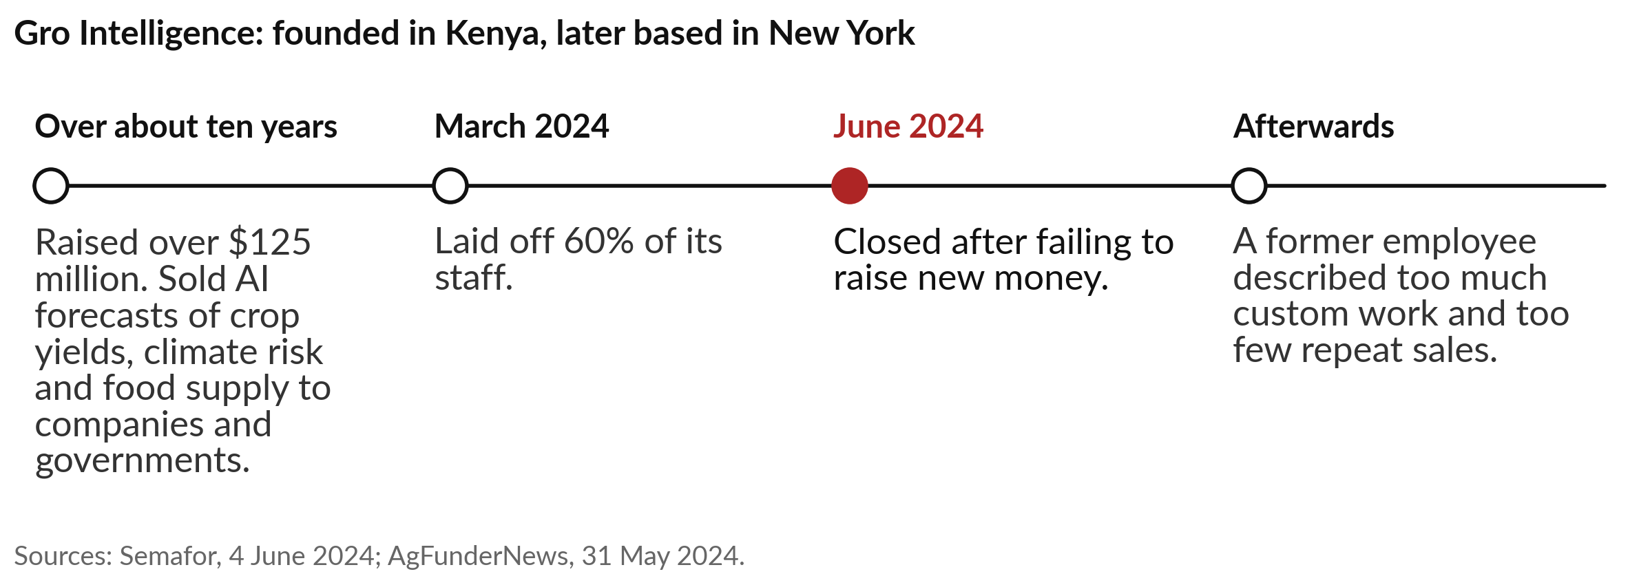
Gro Intelligence, founded in Kenya, raised over
$125 million for AI forecasts and closed in 2024
A forecast earns money only when someone acts on it and pays for it.
Notes:
The third story is a failure, and it is East African. Gro Intelligence was founded in Kenya and later based in New York. It combined government, weather and market data into AI forecasts of crop yields, climate risk and food supply, and sold them to companies and governments.
It raised over 125 million dollars in about ten years. In March 2024 it laid off 60 per cent of its staff, and in June 2024 it closed after failing to raise new money. A former employee described a mismatch between product and market: too much custom work, too few repeat sales.
A prediction is worth something only when it changes a decision someone pays for. Keep that sentence for your portfolio.

Slide 22
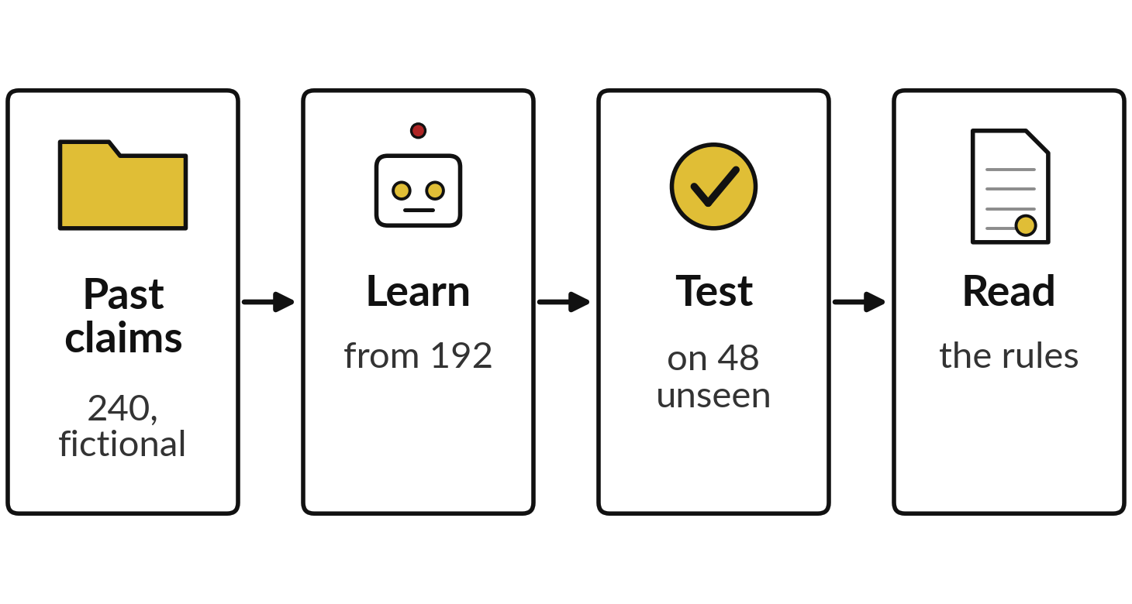
In a recorded run, a model learns which expense
claims to query and is tested on claims it never saw
I will show
Watch for
The rules it learns
How often each rule was right in the past
The score on claims it never saw
Notes:
Now you see one being built, on a task finance teams know. Some expense claims are paid and some are queried. I made 240 fictional claims with a short script: the amount, whether a receipt was attached, how many days after the expense it was filed, and the outcome.
The rule behind them is mine, and I flipped a few outcomes at random to imitate human slips. A model learns from 192 claims and is tested on 48 it never saw. Watch the rules it learns, how often each was right in the past, and the score on unseen claims.
These are recorded runs with scikit-learn, from 5 November 2026, repeated on 11 November with the same results.

Slide 23
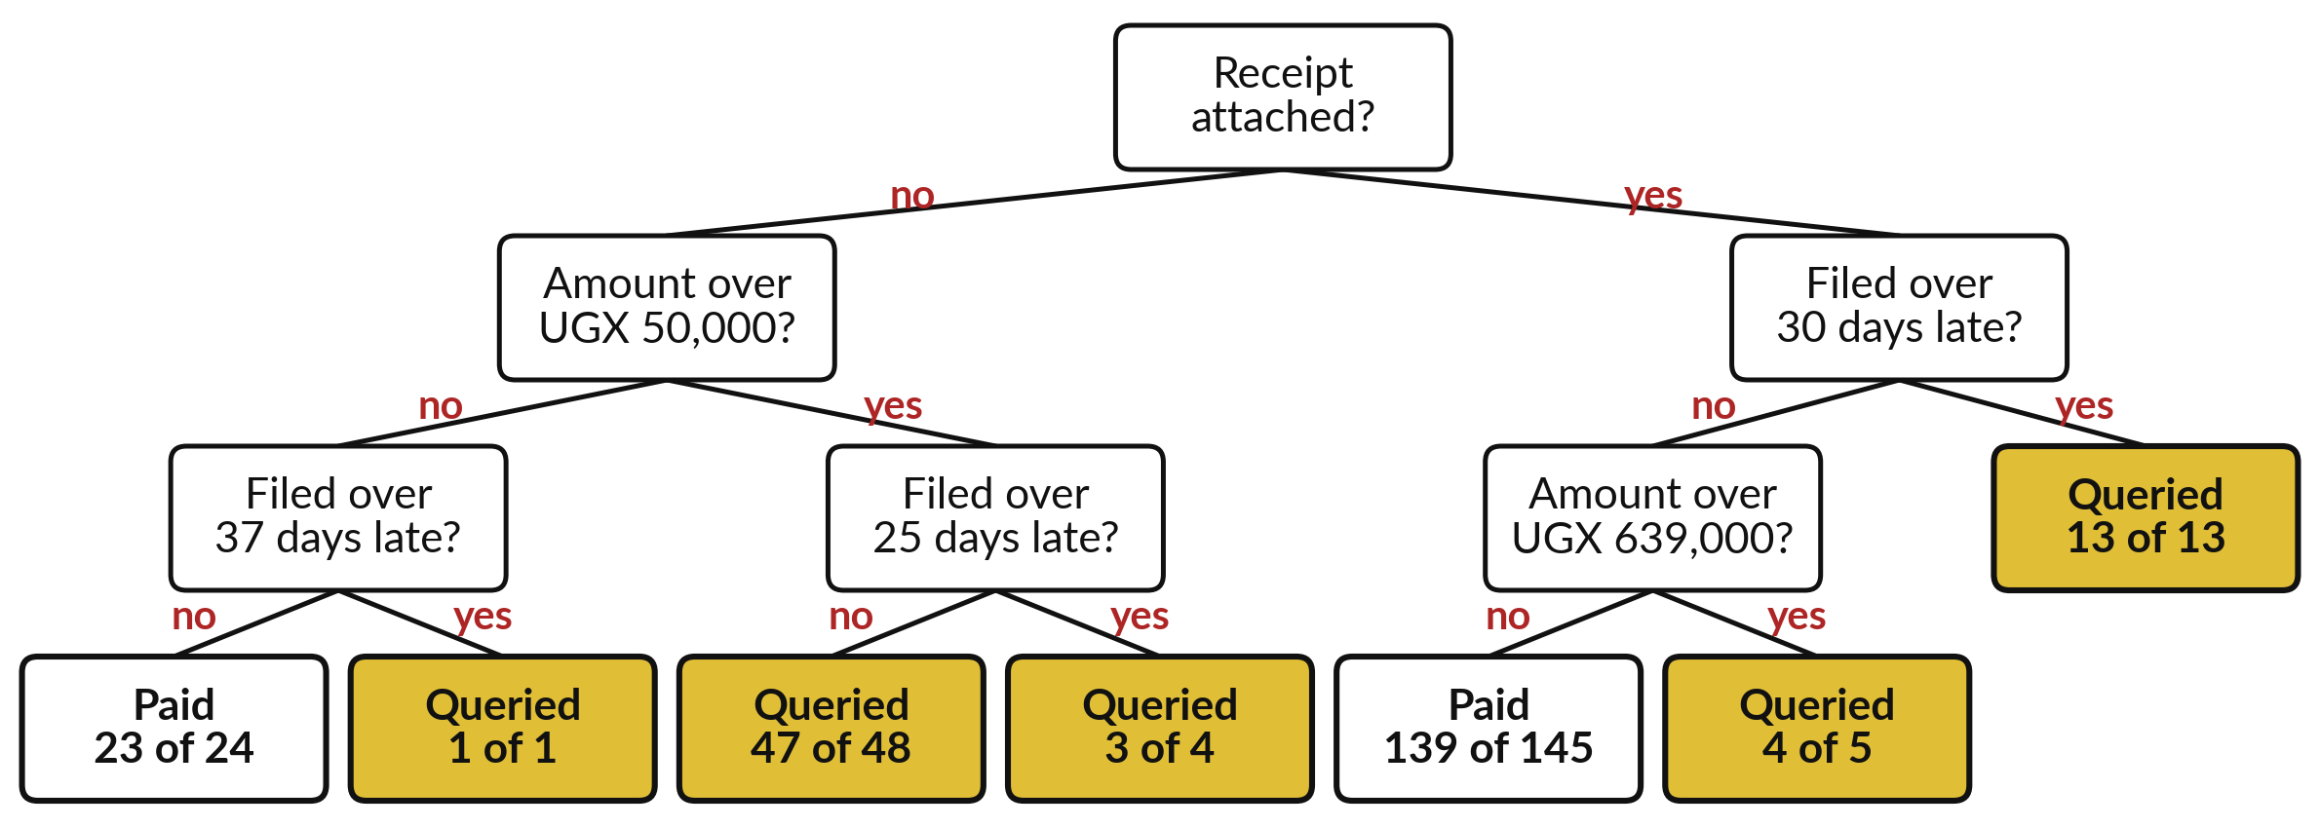
The model learned a tree of plain questions
about the receipt, the amount and the days to file
Drawn from the 240 fictional claims. Recorded run, 5 November 2026. Gold boxes: queried.
Notes:
This is what it learned, drawn as a tree of questions, which the industry calls a decision tree. Start at the top: was a receipt attached?
Without one, the next question is the amount: over UGX 50,000?
Then how late it was filed. Each box at the bottom is an answer, with how many past claims reached it. Follow one claim: UGX 40,000, no receipt, filed after nine days. No receipt, not over 50,000, not over 37 days late: paid. Nobody typed these rules in.
The model found them by trying questions on the past claims and keeping the ones that separated paid from queried best, as the late-payment question did for our borrowers.

Slide 24
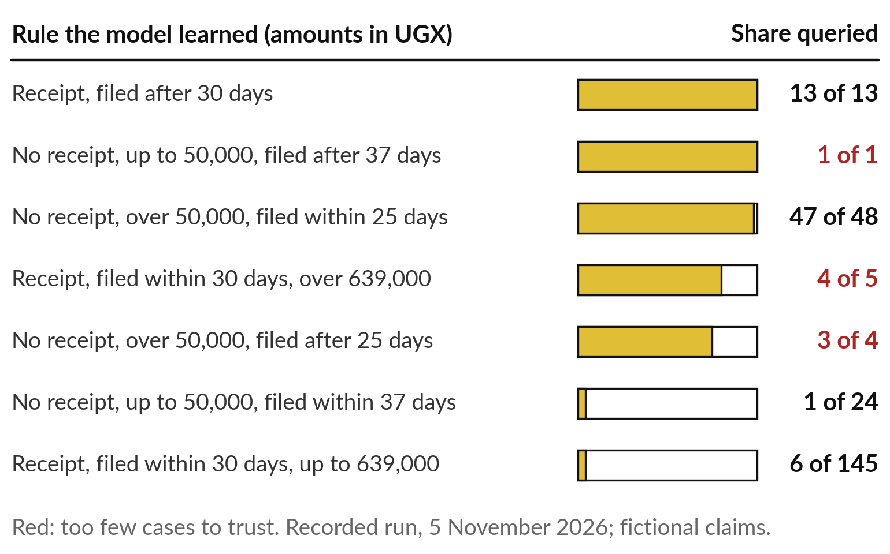
Each rule carries a likelihood: 47 of 48
such claims were queried, against 6 of 145
A new claim takes the share of its rule as its score.
A rule built on only a few claims deserves little trust.
Finance still sets the cut-off.
Notes:
Every rule carries a likelihood, and that is where the score comes from. Claims with no receipt, over UGX 50,000 and filed within 25 days were queried 47 times out of 48. Claims with a receipt, filed within 30 days and up to UGX 639,000, were queried only 6 times out of 145.
A new claim that lands on a rule takes that rule’s share as its score: very likely, or very unlikely, to be queried. The counts in red are small. A rule built on one claim, or on four or five, is a guess, and it may describe a slip. And finance, the people, still choose the cut-off.

Slide 25
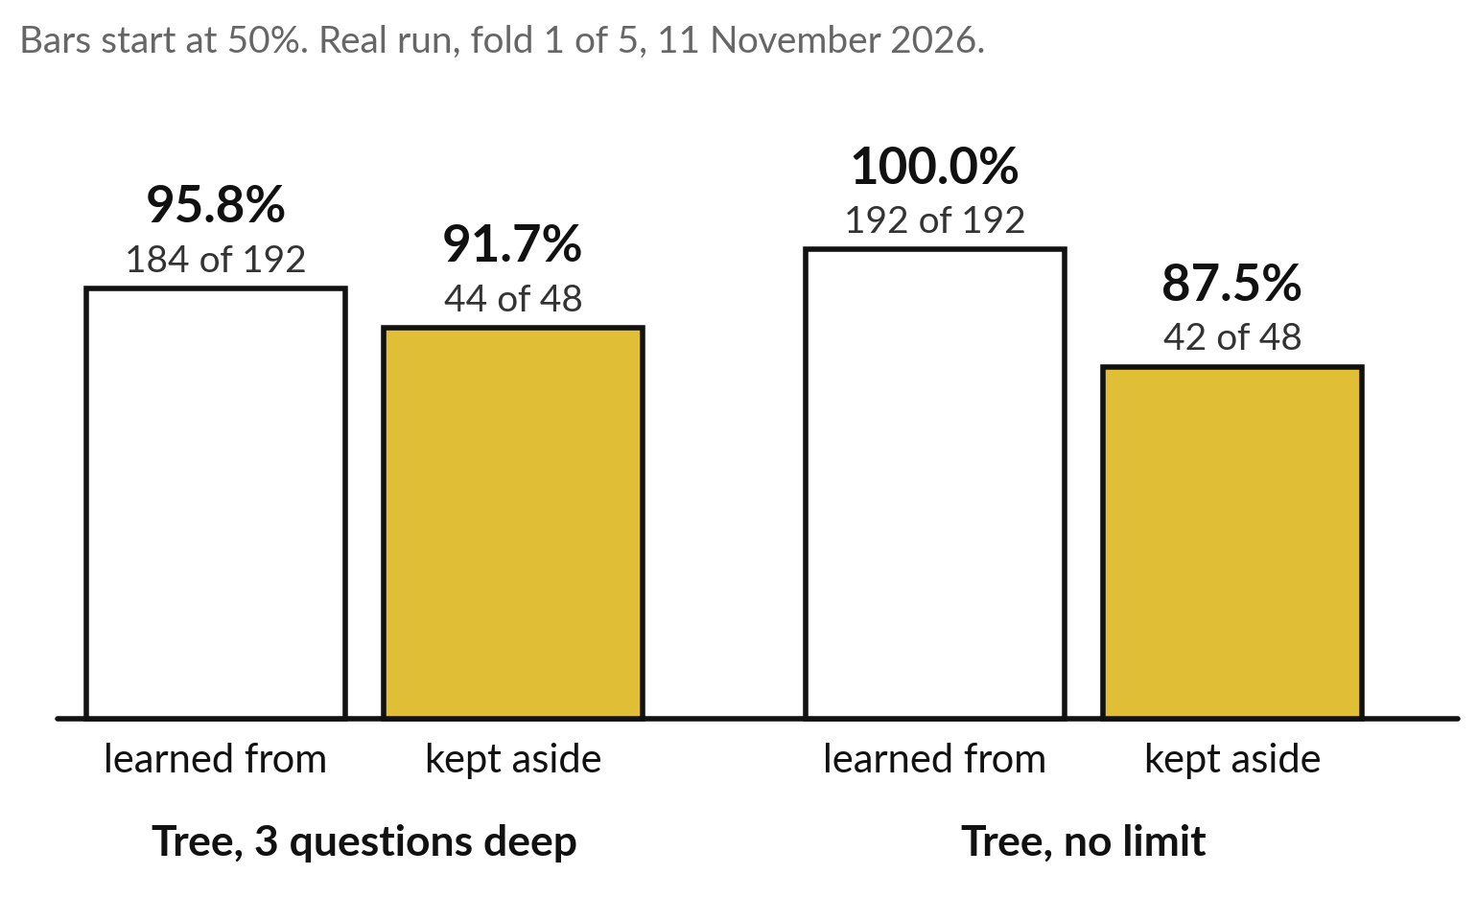
On unseen claims the simple tree got 44 of 48
right; the unlimited tree had learned the slips
Each tree scored twice: on the claims it learned from, and on 48 it never saw.
Over 100 such tests: simple tree 93%, unlimited tree 87.5%.
Notes:
Now the fair test, on the 48 claims kept aside. The tree we just read, limited to three questions deep, got 184 of its 192 learning claims right, and 44 of the 48 unseen claims. Then I let a second tree ask as many questions as it liked.
It got every one of its 192 learning claims right, a perfect score, and only 42 of the 48 unseen ones. That is overfitting in real numbers: it learned the slips I had flipped into the data. If a vendor shows you the first kind of score, ask for the second.
Over 100 such tests, the simple tree averaged 93 per cent and the unlimited one 87.5.

Slide 26
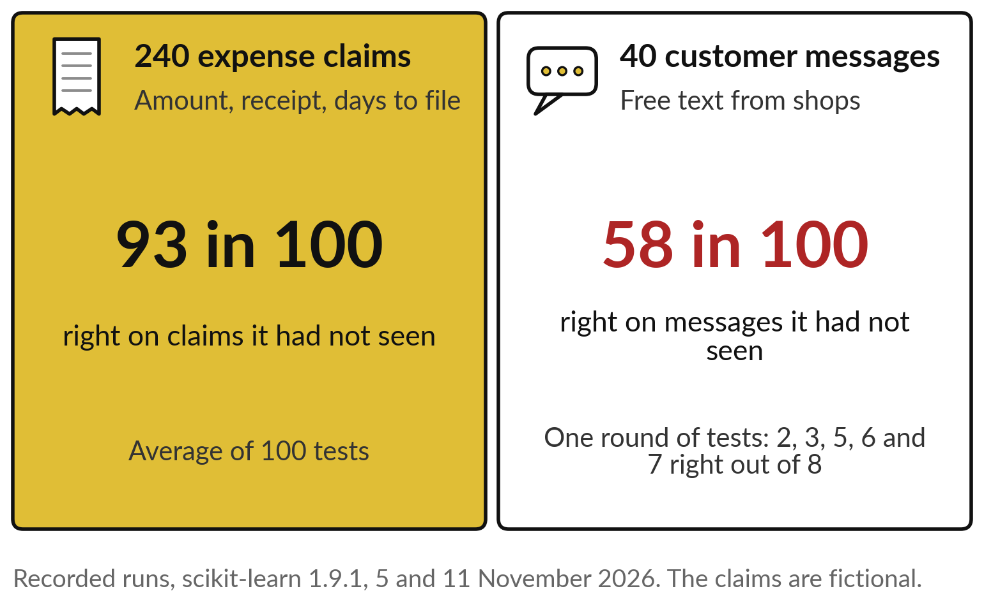
With 240 claims it got 93 in 100 right; with
40 messages about 58, and it swung widely
Enough cases, the third data check, in real numbers.
Forty examples are far too few to learn from words.
Session 4 shows tools built for language.
Notes:
The third data check was enough cases, and the same kind of model on two sets of records shows why. On the 240 claims, with three clear facts each, the simple tree averaged 93 right in every 100 unseen claims, across 100 tests. Then I gave a tree the 40 customer messages of Nile Valley Foods, our fictional company, and asked it to sort them into orders, payments, complaints and other.
It averaged about 58 in 100, and in one round of five tests it got 2, 3, 5, 6 and 7 right out of 8. Forty is far too few to learn from words; Session 4 shows tools built for language.

Slide 27
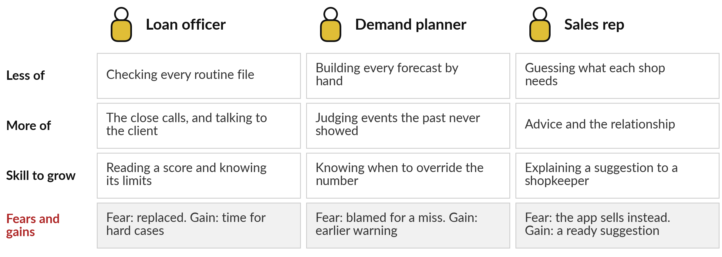
Officers, planners and sales reps do less
routine checking and more judgement
Coca-Cola’s reps still visit; Jacaranda’s help desk answers urgent messages first.
Notes:
A score changes jobs before it changes results, and three roles feel it first. A loan officer checks fewer routine files and spends more time on the close calls and the client conversation. The skill to grow is reading a score and knowing its limits. The fear is being replaced; the gain is time for the hard cases.
A demand planner stops building every forecast by hand and judges what the past never showed. A sales rep stops guessing what each shop needs. Coca-Cola’s reps still visit, alongside the app, and Jacaranda’s help desk now spends its time on the high-risk messages. What do your officers, planners or reps fear about this today?

Slide 28
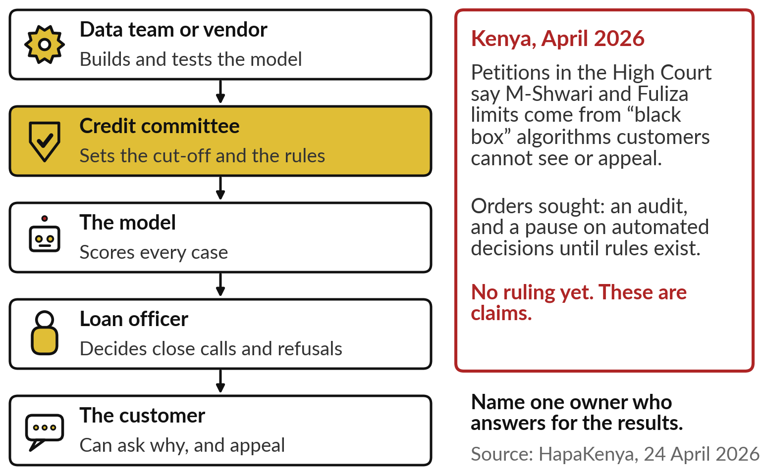
The score supports the decision;
a named person owns it
Write down who does what before the model goes live.
The committee owns the cut-off.
The officer owns each close call.
The customer can ask why.
Notes:
Whatever your people fear, one rule protects them and your customers: the model scores, and people decide. In this lending example, the data team or the vendor builds and tests the model. The credit committee sets the cut-off and the rules, in gold, because that is the real decision.
The model scores every case. A loan officer decides the close calls and the refusals. And the customer can ask why, and appeal. In Kenya, in April 2026, petitions in the High Court claimed that M-Shwari and Fuliza limits come from black-box algorithms customers cannot see or appeal.
These are claims, with no ruling yet. Name one owner who answers for the results.

Slide 29
Six questions that show whether
a prediction deserves your trust
Ask | Why it matters
What records did it learn from, and how many of each outcome? | A rare outcome with few examples gives a weak model
What was the score on records it never saw? | The score on records it has seen flatters
Who set the cut-off, and what does moving it cost? | Every cut-off trades risk against work
What has changed since those records were made? | A new product or a drought breaks the pattern
Who decides the close calls, and can a customer ask why? | Customers expect a reason; check your legal duties
How will we know, each month, that it still works? | Patterns drift as the world changes
Notes:
Everything so far comes down to six questions, for your own team as much as for a vendor. Ask what past records it learned from and how many cases of each outcome, because a rare outcome with few examples gives a weak model. Ask for the score on records it never saw, since the score on seen records flatters.
Ask who set the cut-off and what moving it costs. Ask what has changed since those records were made. Ask who decides the close calls and whether a customer can ask why; check your legal duties there with your lawyer. And ask how you will know each month that it still works, because patterns drift. All six fit in one vendor meeting.

Slide 30
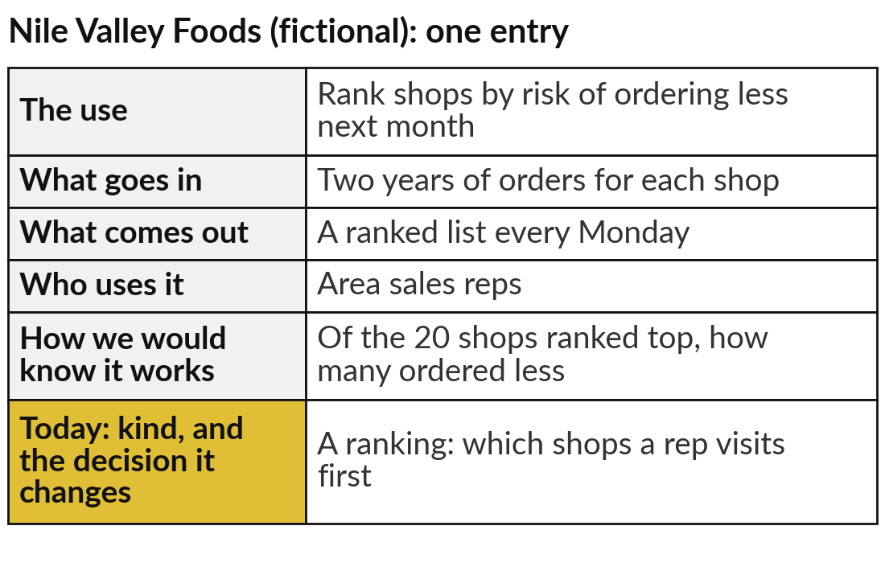
Add one or two predictions to
your AI Opportunity Portfolio
25 minutes
Hands-on: your portfolio
Write a decision your organisation makes often as a prediction.
Name the decision and the outcome to predict.
Fill the five columns, as in the example.
Add today’s column: its kind and the decision it changes.
Run the four data checks.
You keep: One or two portfolio entries, each with its data checks.
Notes:
For twenty-five minutes you work on your own organisation, and I walk round. Open the AI Opportunity Portfolio in your workbook. Choose a decision your organisation makes often, with past records behind it: approving credit, ordering stock, chasing debts, planning shifts or servicing machines. Write it as a prediction.
Fill the five columns: the use, what goes in, what comes out, who uses it, and how you would know it works. Then today’s column: is it a yes or no, a number or a ranking, and which decision does it change?
The example on the right is for Nile Valley Foods, our fictional distributor. Finish with the four data checks, and if one fails, write that down too.

Slide 31

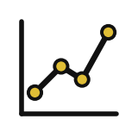


Which decision in your organisation
would a prediction change first?
Of the predictions you just wrote, which would you start with, and why?
Approve or refuse
Plan how much
Who first
Not yet
A yes or no on each case: credit, claims, checks
A number: demand, stock or cash next month
A ranking: which clients or shops to call first
Our records are too few, unlabelled or out of date
Write your decision and the reason in your workbook.
Notes:
With your entries written, one decision. Approve or refuse, if a yes or no on each case would speed up credit, claims or checks. Plan how much, if a better number for demand, stock or cash would save money. Who first, if a ranking would point scarce staff at the right clients.
Or not yet, if your records are too few, unlabelled or out of date. That is an honest and useful answer, because your first project then becomes recording the outcomes. Gro Intelligence is the warning: pick the prediction whose answer someone will act on. Write your choice and the decision it changes, and I will ask two or three of you to read yours out.

Slide 32
Judge a prediction by its
score on records it never saw
Perfect on the claims it had seen, the unlimited tree did worse on new ones.
A prediction is a yes or no, a number or a ranking.
Your policy sets the cut-off.
A named person owns the decision.
Notes:
This is the slide to carry out of the room. The unlimited tree was perfect on the claims it learned from and worse on the 48 it never saw, so the unseen score is the one to ask for. Around it sit the rest of today. Prediction learns from past records whose outcome is known, and it comes as a yes or no, a number or a ranking.
Its score is a likelihood, and your policy sets the cut-off. A named person owns the decision. And the data decides what it can learn: 93 in 100 on the 240 claims, about 58 in 100 on forty messages.

Slide 33
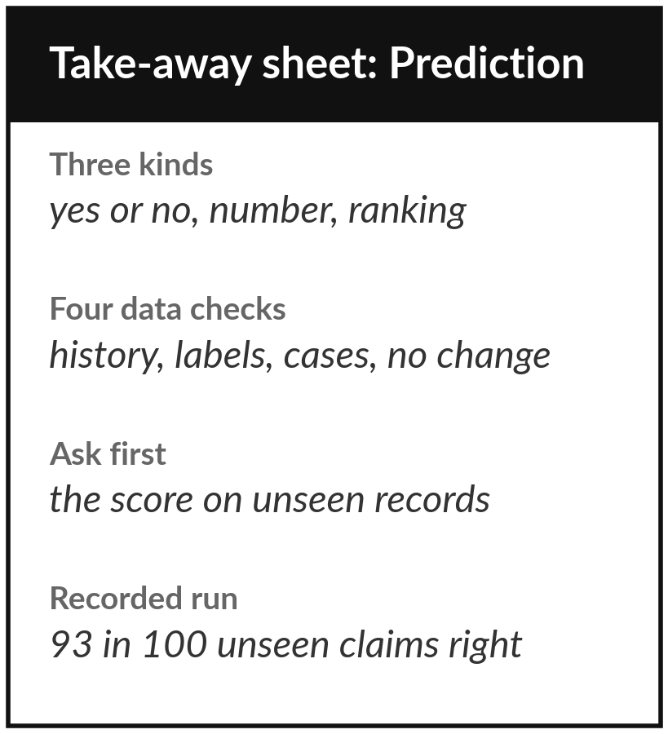
Keep the sheet, and the prediction
you added to your portfolio
What you keep from today
A one-page sheet: the three kinds of prediction, the four data checks, the questions to ask, today’s recorded results, and your new portfolio entries.
Our question today
Who will default, leave, buy, fall sick or break down next, and can we trust the answer?
Next session
Session 3: Is it any good? Accuracy claims and the cost of mistakes.
Notes:
The take-away sheet carries the three kinds of prediction, the four data checks, the six questions for your team and your vendor, and today’s recorded numbers: 93 in 100 unseen claims right, about 58 in 100 of the forty messages, and the unlimited tree that was perfect on what it had seen and worse on what it had not.
Your portfolio now holds a prediction tied to a decision. In Session 3 we take the vendor’s favourite claim, ninety-five per cent accurate, and ask what each mistake costs.
We began with this question: Who will default, leave, buy, fall sick or break down next, and can we trust the answer? Before you go, say in one sentence what you can now say about it.

